Slide 1
Vanguard
A/B Testing
Sergii & Rosi

Slide 2

Introduction
About Vanguard
Leading US-based investment management company.
Commitment to innovation and enhancing customer experience.
Context of the Digital Challenge
Vanguard launched a digital experiment to enhance user interface (UI) for clients.
Aimed to improve online process efficiency and completion rates.
Main Question
Did the new UI lead to higher completion rates?
Notes:
About Vanguard
Leading US-based investment management company
Founded in 1975, client-owned, known for low-cost investment options and long-term investing philosophy
Key Services: Mutual funds, ETFs, retirement planning, wealth management

Slide 3
Data Overview
Client Profiles
age, gender, and account details of the clients (tenure, number of account, balance)
Digital Footprints
Detailed trace of client interactions online (visitor id, visit id, process step, date time)
Experiment Roster (A/B Testing)
Lists clients participating in the experiment (variation)
Notes:
Client Profiles (df_final_demo)
Contains demographic information such as age, gender, and account details of the clients.
Digital Footprints (df_final_web_data)
Detailed trace of client interactions online, split into two parts: pt_1 and pt_2.
Merge these files for a comprehensive data analysis.
Experiment Roster (df_final_experiment_clients)
Lists clients participating in the grand experiment.

Slide 4
Data Cleaning and Wrangling
Cleaned the NA values in the merged data frame to ensure data integrity.
Standardized the 'sex' column to ensure consistency in gender representation.
Categorized the dataframe into test and control groups for further analysis.
Segmented the data into different steps based on the 'process_step' column.
Identified users who completed the entire process from 'start' to 'confirm' and categorized them accordingly.
Grouped users based on their 'visit_id' to account for users who completed the process over multiple days.
Converted the date into days and time into minutes for better analysis and visualization.
Notes:
Client Profiles (df_final_demo)
Contains demographic information such as age, gender, and account details of the clients.
Digital Footprints (df_final_web_data)
Detailed trace of client interactions online, split into two parts: pt_1 and pt_2.
Merge these files for a comprehensive data analysis.
Experiment Roster (df_final_experiment_clients)
Lists clients participating in the grand experiment.

Slide 5
Challenges
Challenge: User Navigation Complexity
Many users exhibited erratic behavior, navigating back and forth between process steps, complicating analysis.
Difficulty in tracking and analyzing user paths due to inconsistent navigation patterns.
Solution: Streamlined Filtering Approach
Implemented a streamlined filtering approach based on unique visit IDs to isolate users who initiated and completed the entire process, ignoring intermediate steps.

Slide 6
Challenges & Learnings
Challenge: Time Outliers and Data Integrity
Some users completed the process over multiple days, introducing outliers and skewing time-based analyses.
Inability to accurately calculate duration and time intervals due to non-conforming data format.
Solution: Date-Based Filtering
Applied date-based filtering based on visit IDs to exclude users with prolonged completion times, ensuring data integrity and consistency.
Focus shifted to analyzing users who completed the process within a reasonable time frame, aligning with experiment objectives.

Slide 7

User Demographics
Majority of users fall within the age groups of 31-40 to 61-70 years old, indicating a diverse user base across different age brackets.
Gender distribution skews towards male users, suggesting a higher representation of males compared to females in the dataset.

Slide 8

User Behaviors
Long-standing relationship with Vanguard: Users have been associated with the company for 2-20 years, indicating loyalty and trust in Vanguard's services.
Account balance ranges from 23,789 to 1M, highlighting the varying financial capacities and investment levels among users.
Most users maintain 1-3 accounts, indicating a preference for managing a manageable number of accounts for their investments.

Slide 9
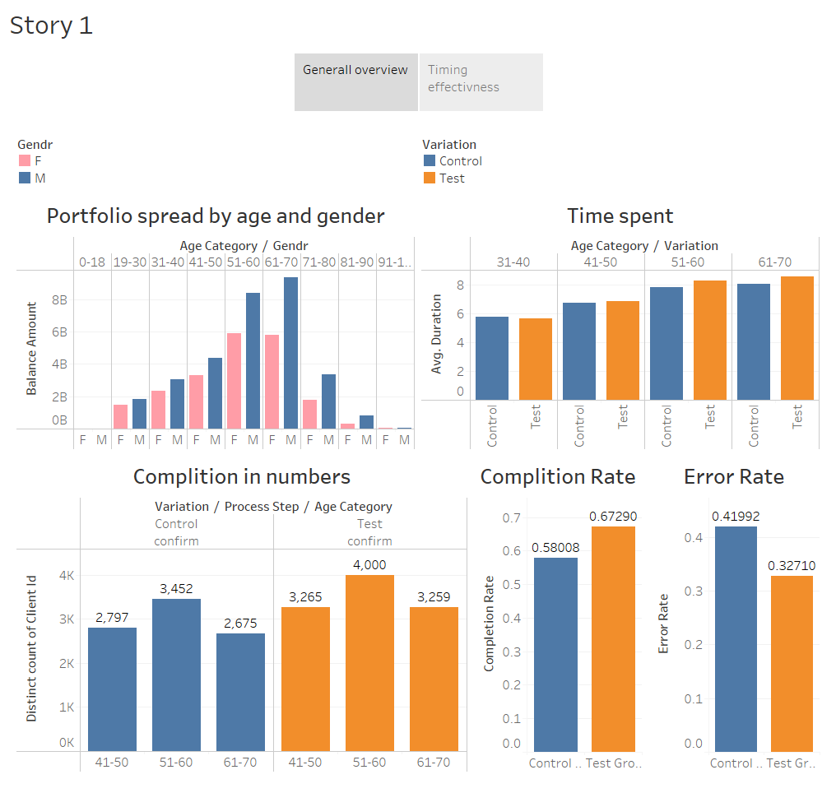
Completion Rates between the Control and Test Groups
The test group demonstrates a higher completion rate (0.6729) compared to the control group (0.5801), indicating a potential improvement in the effectiveness of the implemented changes or interventions.

Slide 10
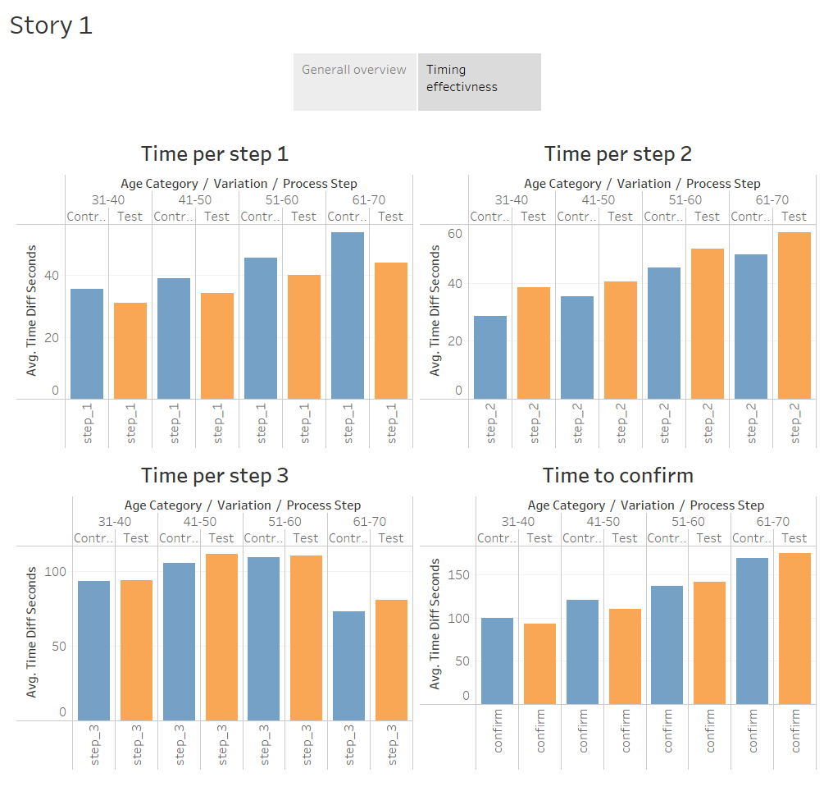
Time Spent each Step between the Control and Test Groups
The test group exhibits a slightly longer average time spent on each step (8 minutes) compared to the control group (7 minutes), indicating potential differences in user engagement and interaction patterns between the two groups.

Slide 11
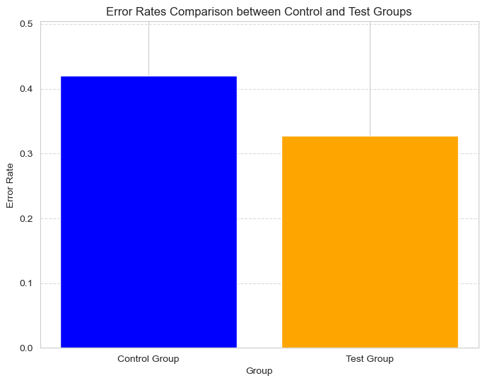
Error Rates between the Control and Test Groups
The test group demonstrates a lower error rate (0.3) compared to the control group (0.4), indicating potential improvements or optimizations in the tested design or intervention.

Slide 12
Hypothesis Testing Completion Rates
Control Completion Rate: 58.01%
Test Completion Rate: 67.29%
Test Statistic: -21.64
p-value: 2.09e-103
Decision: Reject the null hypothesis
The hypothesis tests aimed to evaluate differences in completion rates between the control and test groups.
The test results indicate a statistically significant difference in completion rates between the two groups.
With a p-value much lower than the significance level, there is strong evidence to reject the null hypothesis.

Slide 13
Hypothesis Testing Time Spent
Control Group Time: 7 minutes
Test Group Time: 8 minutes
Test Statistic: 2.89
Degrees of Freedom: 50485
p-value: 0.0078
Decision: Reject the null hypothesis
The hypothesis tests aimed to examine differences in the time spent on each step between the control and test groups.
The test results indicate a statistically significant difference in the time spent on each step between the two groups.
With a p-value less than the significance level, there is strong evidence to reject the null hypothesis.

Slide 14
Hypothesis Testing Error Rates
Chi-square Statistic: 463.73
Degrees of Freedom: 1
p-value: 7.41e-103
Decision: Reject the null hypothesis
The hypothesis tests aimed to assess differences in error rates between the control and test groups.
The test results reveal a statistically significant difference in error rates between the two groups.
With an extremely low p-value (< 0.05), there is compelling evidence to reject the null hypothesis.

Slide 15
Experiment Evaluation
Randomization:
Reducing selection bias and ensuring that the groups are comparable.
Increases the internal validity of the experiment.
It ensures that any differences observed between the groups can be attributed to the intervention or treatment rather than other factors.
Duration:
The duration of the experiment is an important consideration to account for potential time-related biases and ensure the stability of the findings over time.
Longer durations allow for capturing trends, variations, and potential seasonality effects that may impact the results.
Potential Biases:
Selection Bias: Despite randomization, there may still be differences between the control and test groups due to factors not accounted for in the randomization process.
Attrition Bias: Participants dropping out of the study or incomplete data may introduce bias if the attrition rates differ significantly between the groups.
Observer Bias: The individuals analyzing the data or interpreting the results may have preconceived notions or expectations, potentially biasing their assessments.

Slide 16
Experiment Evaluation
Demographic Information: Collecting more detailed demographic data such as income level, education, or geographic location could provide insights into how different user segments respond to the intervention.
User Feedback: Gathering qualitative feedback through surveys, interviews, or usability testing can offer valuable insights into user perceptions, preferences, and experiences.
Engagement Metrics: Tracking user engagement metrics such as session duration, click-through rates, or interaction patterns can help assess the effectiveness of the intervention and identify areas for improvement.
Control Variables: Including additional control variables such as user activity level, device type, or browser version can help control for potential confounding factors and improve the robustness of the analysis.

Slide 17
Key Findings
The higher completion rate in the test group may signify better alignment with user preferences, leading to increased user satisfaction and a higher likelihood of desired actions or outcomes being achieved.
The increase in time spent on each step in the test group may suggest greater user attention, involvement, or interaction with the content, features, or functionalities presented during the process.
The decrease in error rate in the test group may result from user-centric design changes, streamlined workflows, or enhanced user guidance and support implemented as part of the test intervention.

Slide 18
Recommendations
Capitalize on the insights gained from the test group's positive outcomes to inform future interface design and development efforts.
Invest in ongoing user testing and feedback collection to ensure continuous refinement and enhancement of digital experiences.
Explore additional strategies for minimizing errors and improving usability to further enhance the overall user experience and achieve business objectives.

Slide 19
Conclusion
Based on the analysis, the new digital interface demonstrates promising results, showing improvements in completion rates, user engagement, and error reduction compared to the previous design. These findings suggest that the new interface is effective in enhancing user experience and achieving business objectives. Therefore, it is recommended to proceed with the implementation of the new interface across Vanguard's digital platforms.

Slide 20

Thank You!

